Slide 1
QA Dashboard Demo
View in Power BI
Last data refresh:
30/05/2022 7:35:08 UTC
Downloaded at:
17/07/2023 10:01:15 UTC

Slide 2
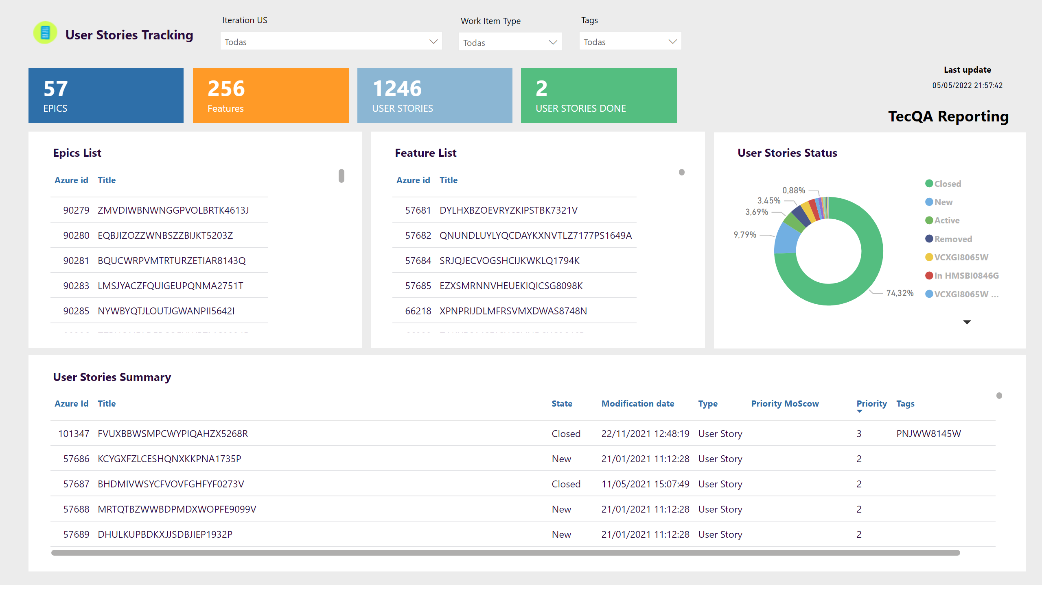
User Stories Tracking
Notes:
image
No alt text provided
textbox
No alt text provided
multiRowCard
No alt text provided
multiRowCard
No alt text provided
multiRowCard
No alt text provided
Ticket Status
No alt text provided
basicShape
No alt text provided
textbox
No alt text provided
Ticket List
No alt text provided
basicShape
No alt text provided
textbox
No alt text provided
Ticket List
No alt text provided
basicShape
No alt text provided
textbox
No alt text provided
Ticket List
No alt text provided
basicShape
No alt text provided
textbox
No alt text provided
Last update
No alt text provided
multiRowCard
No alt text provided
actionButton
No alt text provided
slicer
No alt text provided
slicer
No alt text provided
slicer
No alt text provided

Slide 3
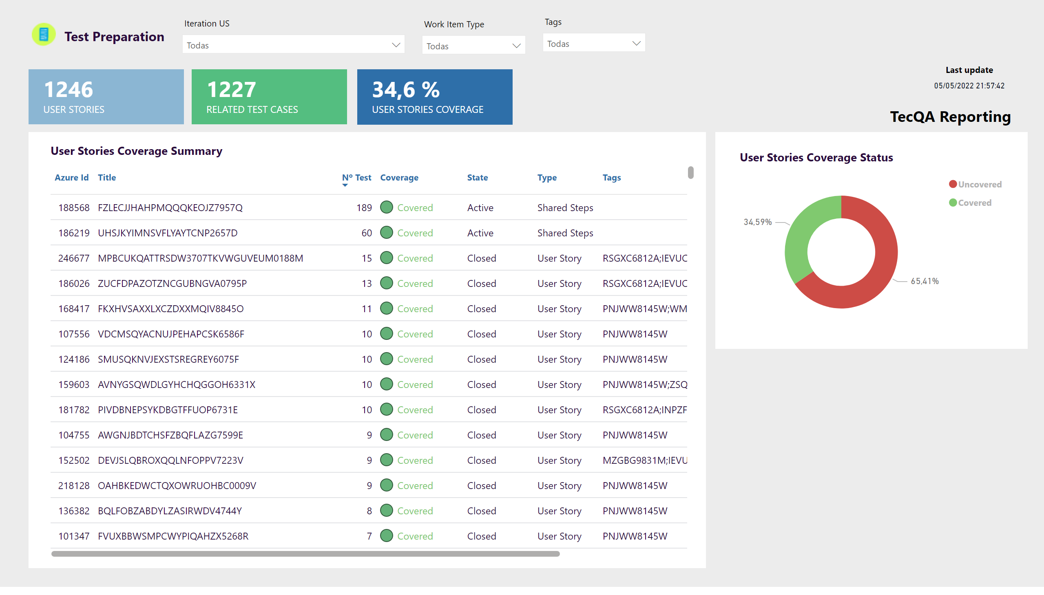
Test Preparation
Notes:
image
No alt text provided
textbox
No alt text provided
slicer
No alt text provided
slicer
No alt text provided
multiRowCard
No alt text provided
multiRowCard
No alt text provided
Ticket Status
No alt text provided
basicShape
No alt text provided
textbox
No alt text provided
Ticket List
No alt text provided
basicShape
No alt text provided
textbox
No alt text provided
multiRowCard
No alt text provided
Last update
No alt text provided
actionButton
No alt text provided
slicer
No alt text provided

Slide 4
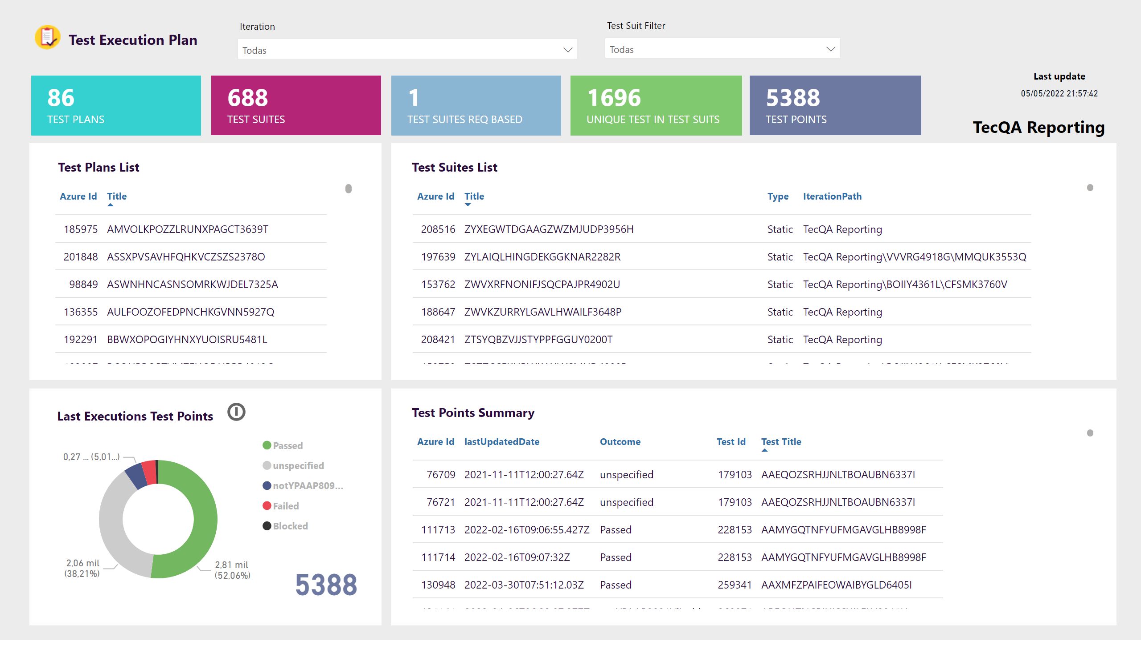
Test Execution Plan
Notes:
textbox
No alt text provided
slicer
No alt text provided
multiRowCard
No alt text provided
multiRowCard
No alt text provided
multiRowCard
No alt text provided
Ticket List
No alt text provided
basicShape
No alt text provided
textbox
No alt text provided
Ticket List
No alt text provided
basicShape
No alt text provided
textbox
No alt text provided
Ticket Status
No alt text provided
basicShape
No alt text provided
textbox
No alt text provided
multiRowCard
No alt text provided
slicer
No alt text provided
Ticket List
No alt text provided
basicShape
No alt text provided
textbox
No alt text provided
image
No alt text provided
actionButton
No alt text provided
textbox
No alt text provided
shape
No alt text provided
textbox
No alt text provided
actionButton
No alt text provided
Last update
No alt text provided
actionButton
No alt text provided
multiRowCard
No alt text provided
card
No alt text provided

Slide 5
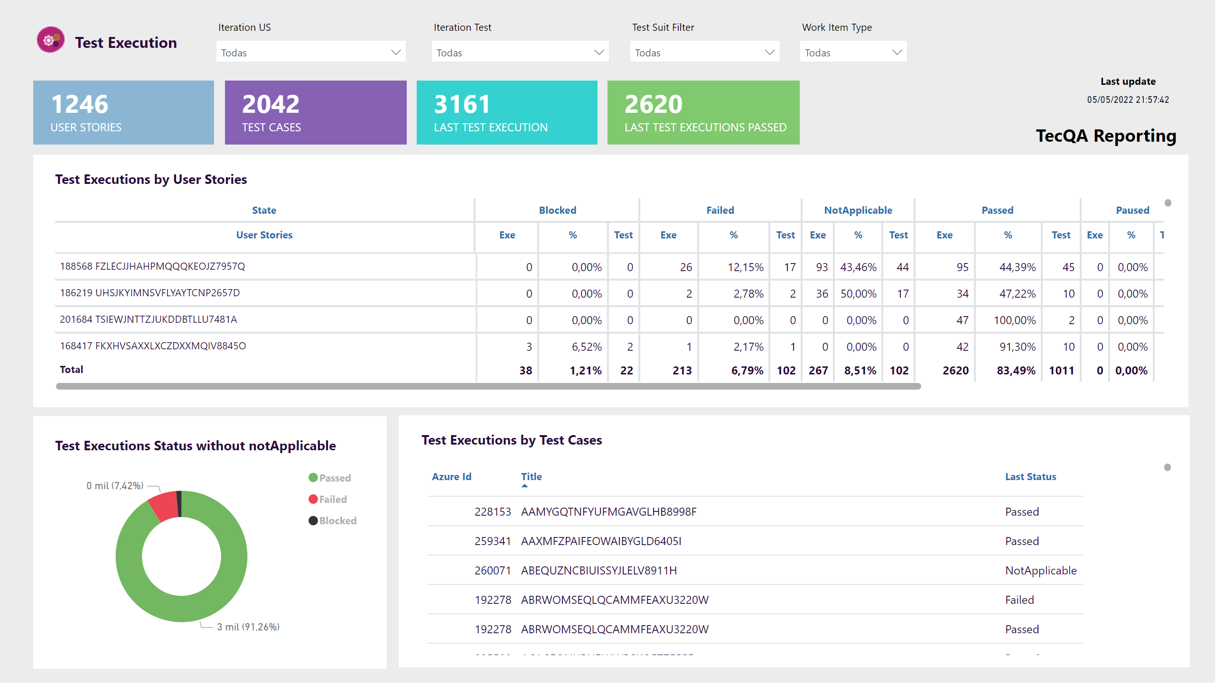
Test Executions
Notes:
Last update
No alt text provided
actionButton
No alt text provided
slicer
No alt text provided
slicer
No alt text provided
Ticket List
No alt text provided
image
No alt text provided
textbox
No alt text provided
basicShape
No alt text provided
Ticket List
No alt text provided
multiRowCard
No alt text provided
multiRowCard
No alt text provided
slicer
No alt text provided
slicer
No alt text provided
textbox
No alt text provided
basicShape
No alt text provided
multiRowCard
No alt text provided
textbox
No alt text provided
basicShape
No alt text provided
Ticket Status
No alt text provided
multiRowCard
No alt text provided
textbox
No alt text provided

Slide 6
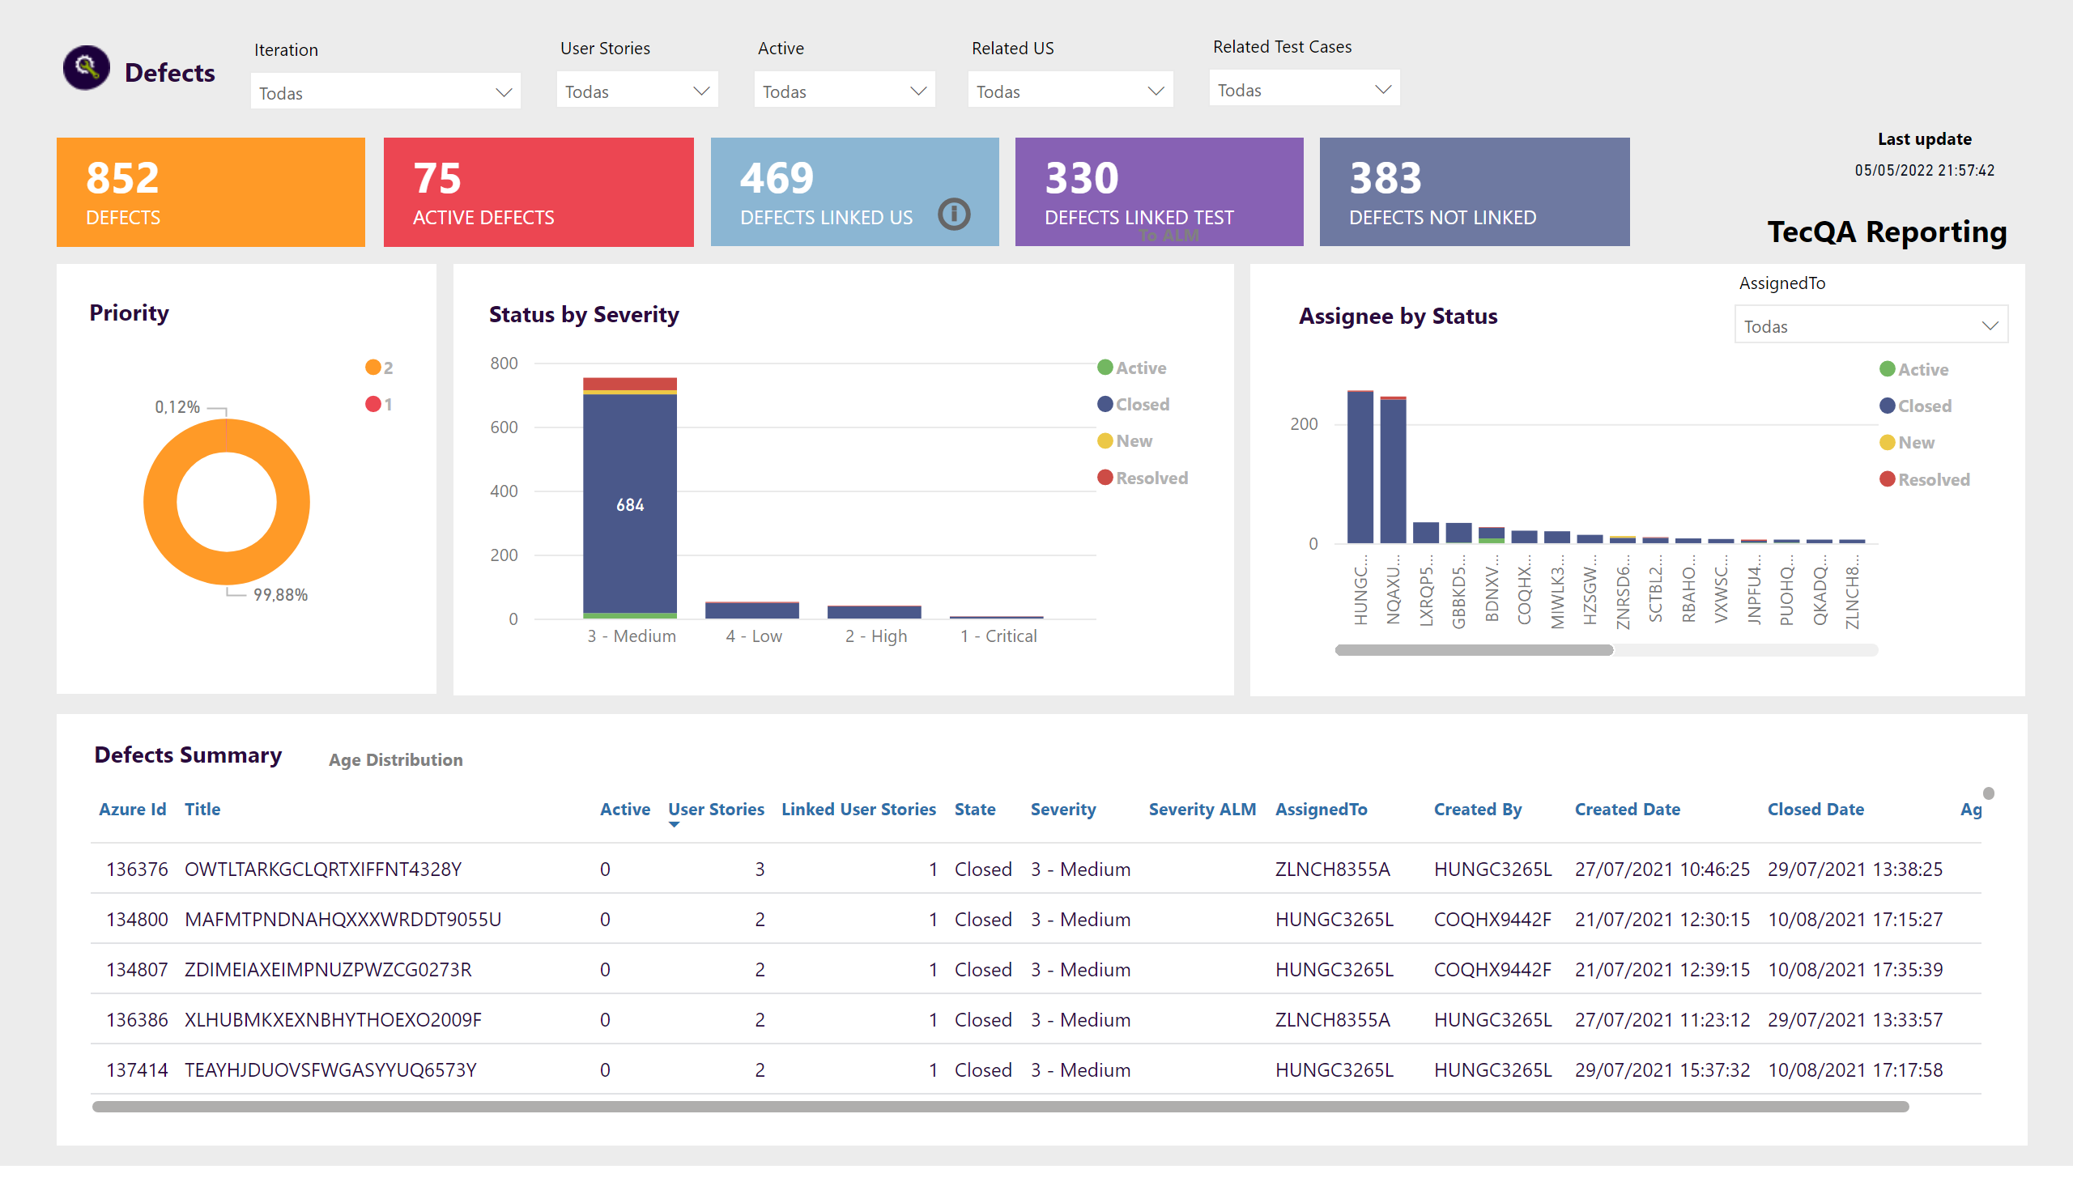
Defects
Notes:
textbox
No alt text provided
slicer
No alt text provided
slicer
No alt text provided
multiRowCard
No alt text provided
multiRowCard
No alt text provided
multiRowCard
No alt text provided
multiRowCard
No alt text provided
multiRowCard
No alt text provided
Ticket Status
No alt text provided
basicShape
No alt text provided
textbox
No alt text provided
columnChart
No alt text provided
basicShape
No alt text provided
textbox
No alt text provided
Ticket List
No alt text provided
basicShape
No alt text provided
textbox
No alt text provided
Ticket Status
No alt text provided
basicShape
No alt text provided
textbox
No alt text provided
slicer
No alt text provided
slicer
No alt text provided
actionButton
No alt text provided
Ticket Status
No alt text provided
basicShape
No alt text provided
textbox
No alt text provided
actionButton
No alt text provided
image
No alt text provided
slicer
No alt text provided
slicer
No alt text provided
Last update
No alt text provided
actionButton
No alt text provided
actionButton
No alt text provided
actionButton
No alt text provided
basicShape
No alt text provided
textbox
No alt text provided
columnChart
No alt text provided
textbox
No alt text provided
shape
No alt text provided
textbox
No alt text provided
actionButton
No alt text provided
actionButton
No alt text provided

Slide 7
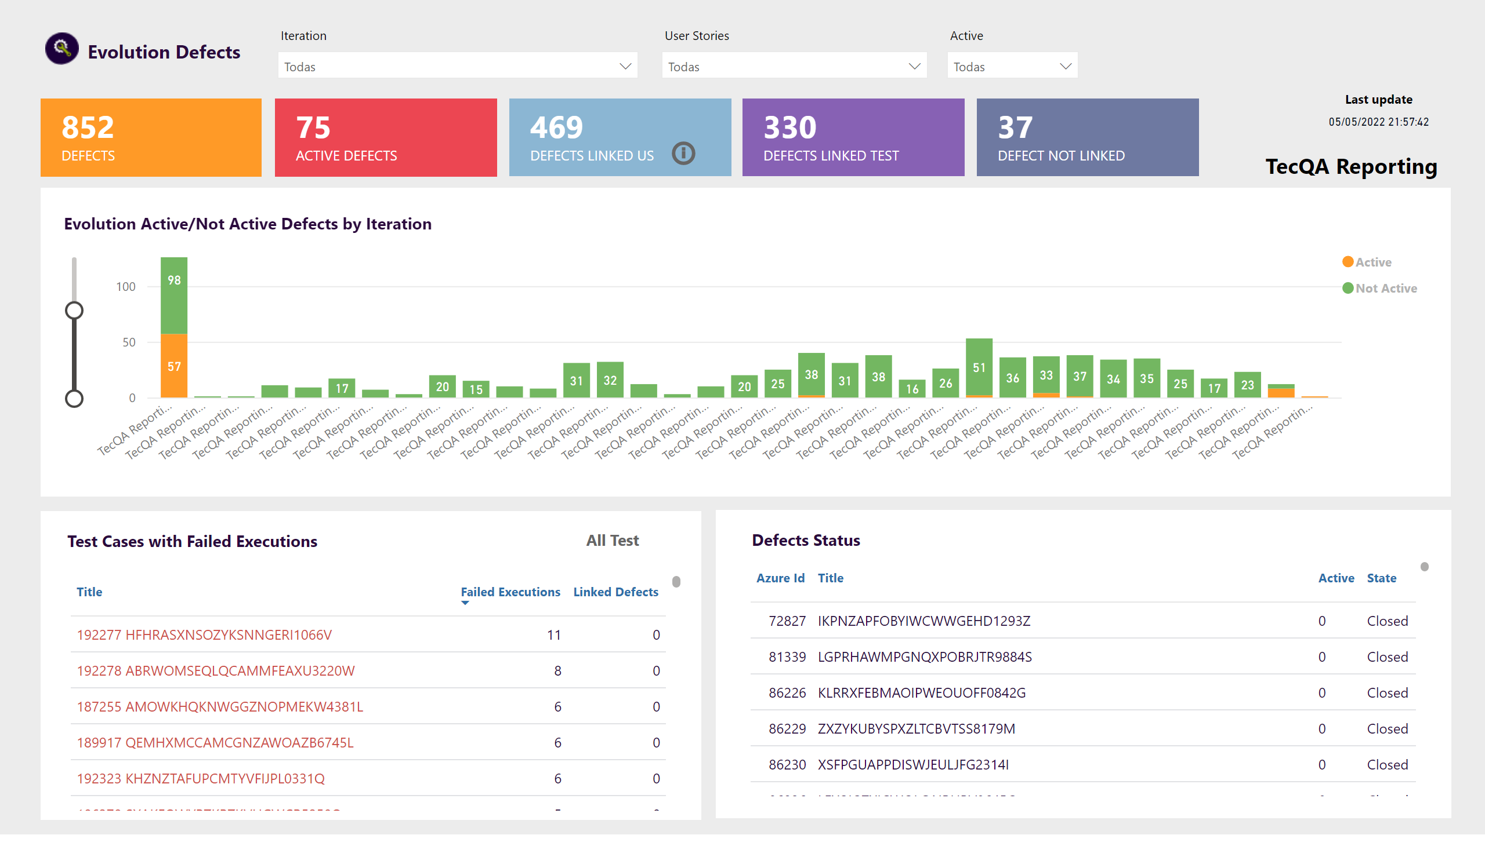
Evolution Defects
Notes:
textbox
No alt text provided
slicer
No alt text provided
slicer
No alt text provided
multiRowCard
No alt text provided
multiRowCard
No alt text provided
multiRowCard
No alt text provided
multiRowCard
No alt text provided
multiRowCard
No alt text provided
Ticket Status
No alt text provided
basicShape
No alt text provided
textbox
No alt text provided
tableEx
No alt text provided
basicShape
No alt text provided
textbox
No alt text provided
slicer
No alt text provided
Ticket List
No alt text provided
basicShape
No alt text provided
textbox
No alt text provided
image
No alt text provided
actionButton
No alt text provided
actionButton
No alt text provided
Ticket List
No alt text provided
Last update
No alt text provided
actionButton
No alt text provided
actionButton
No alt text provided
textbox
No alt text provided
textbox
No alt text provided
shape
No alt text provided
actionButton
No alt text provided

Slide 8
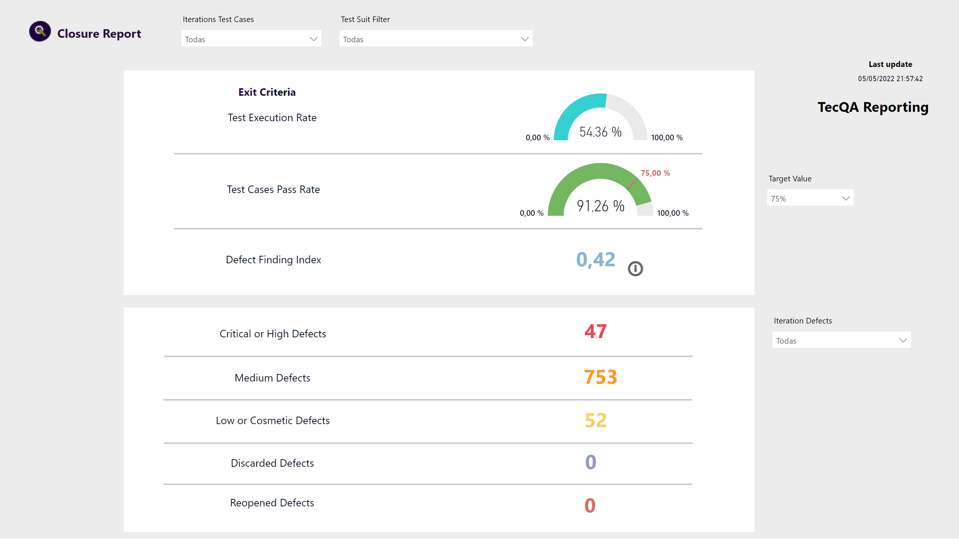
Closure Report
Notes:
textbox
No alt text provided
slicer
No alt text provided
multiRowCard
No alt text provided
slicer
No alt text provided
image
No alt text provided
basicShape
No alt text provided
textbox
No alt text provided
textbox
No alt text provided
textbox
No alt text provided
textbox
No alt text provided
gauge
No alt text provided
shape
No alt text provided
shape
No alt text provided
basicShape
No alt text provided
textbox
No alt text provided
shape
No alt text provided
multiRowCard
No alt text provided
textbox
No alt text provided
shape
No alt text provided
multiRowCard
No alt text provided
textbox
No alt text provided
shape
No alt text provided
multiRowCard
No alt text provided
textbox
No alt text provided
shape
No alt text provided
textbox
No alt text provided
multiRowCard
No alt text provided
multiRowCard
No alt text provided
slicer
No alt text provided
Last update
No alt text provided
actionButton
No alt text provided
gauge
No alt text provided
slicer
No alt text provided
actionButton
No alt text provided
textbox
No alt text provided
textbox
No alt text provided
shape
No alt text provided
actionButton
No alt text provided

Slide 9
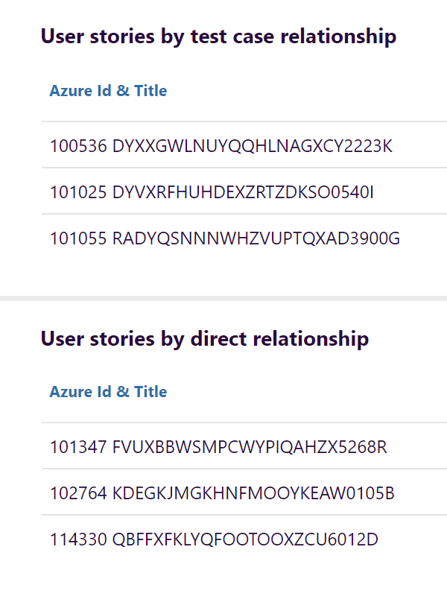
ToolTip
Notes:
basicShape
No alt text provided
textbox
No alt text provided
Ticket List
No alt text provided
basicShape
No alt text provided
textbox
No alt text provided
Ticket List
No alt text provided

