Slide 2
Flourishing digital business with quality engineering & testing
CONTINUOUS QUALITY ENGINEERING & TESTING
TEST AUTOMATION OBSERVATORY
COGNITIVE QA
SPIDER LINKS CHECKER
SMART
& AUTOMATED
QE & TESTING
Frameworks design, implementation, and integration (desktop, web, mobile)
Automation tests development, execution, and reporting
APPLIED INNOVATION
QADASHBOARDS
SPECIALIZED
QE & TESTING
Performance
Accessibility
Security
Code analysis
Mobile
Crowd
TEST
DATA
MANAGEMENT
Synthetic data generation
Subsetting/masking data generation
Data privacy services
Data information governance (DIG)
SOGETI
FRAMEWORKS
LEGACY, DIGITAL, MODERN AND CLOUD-BASED SOLUTIONS
DOMAIN-SPECIFIC
QE & TESTING
Cloud apps
SAP
Metaverse and VR/AR
ADA
DIG
SUSTAINABILITY
VR/AR TESTING FRAMEWORK
CLOUD TESTING FRAMEWORK
SAP REUSABLE TESTS
STRUCTURED
E2E QUALITY
STRATEGY
Testing & QE strategy based on TMAP
Tests design & execution of different types and levels
CLOUD
FOUNDATION
WITH QUALITY BY DESIGN
Dev(QA)Ops set-up and integration
AGILE &
DEVOPS
WORKSPACE
POD teams
Azure DevOps and JIRA set-up
CLOUD SERVICES &
LICENSING
PROVISIONING
QE&Testing partnerships
EVOLUTION
ROADMAP
TO MAXIMIZE VALUE
Test Process Improvement (TPI & QBP)
SUSTAINABLE
SOFTWARE
ENGINEERING
TMap test strategy including sustainability core
#DigitalBusinessWithQuality
#FlourishingWithSogeti
DEV(QA)OPS BLUEPRINT
TMAP SUSTAINABILITY FRAMEWORK
POD TEAMS
TPI / QBP
TMAP
SOGETI HUB

Slide 3
Hacia SmartQA
Aprovechar las capacidades de predicción, analítica avanzada e IA para aportar inteligencia y eficiencia a las actividades de QA
Automated
Testing & CI/CD
+
Robot Process Automation (RPA)
Structured testing & QA processes
+
Smart QA
Smart Analytics & data insights
QADashboards & CognitiveQA
Modelos
Smart
+
Métricas
IA-based models
Datos
La inteligencia (artificial) implica:
Capturar datos
Tratar los datos para convertirlos en información y razonar (conocimiento)
Aplicar el conocimiento
Smart=
Datos +
automatización + IA
Notes:
En este bloque, presentamos nuestro enfoque “Smart QA”. SmartQA responde al objetivo de Sogeti de ayudar a nuestros clientes a conseguir un nivel avanzado en la optimización y eficiencia de los procesos y actividades de Testing y Quality Assurance aplicando técnicas y soluciones para un testing y QA más “smarts” (espabilado, inteligente).
La base para conseguirlo implica ir implantando progresivamente varias soluciones:
- Automatización de pruebas
– CI/CD (integración continua y tareas automatizadas –más allá de las pruebas- en una cadena DevOps, a través de APIs de les herramientas).
Aun así, van a quedar tareas administrativas (por ejemplo: dar de alta usuarios, enviar mails con reportes, reportar horas del proyecto, etc.) que van a seguir siendo stoppers en el proceso. Aquí, hay posibilidad de automatizar este tipo de tareas también a través de Robot Process Automation (RPA).
Además, a medida que vamos automatizando, podemos usar la solución CognitiveQA para dotarnos de dashboards, analytics e insights para ayudar a la gestión de la calidad e ir un paso más allá aplicando también modelos cognitivos basados en inteligencia artificial para conseguir anticipación y asistencia a las actividades de QA y Testing.
Todo ello require como base un proceso continuo de mejora (que guiamos mientras aplicamos las técnicas y soluciones centrales) del proceso de pruebas estructurado y de como los datos de QA y testing se almacenan, se trazan y se gestionan.

Slide 4
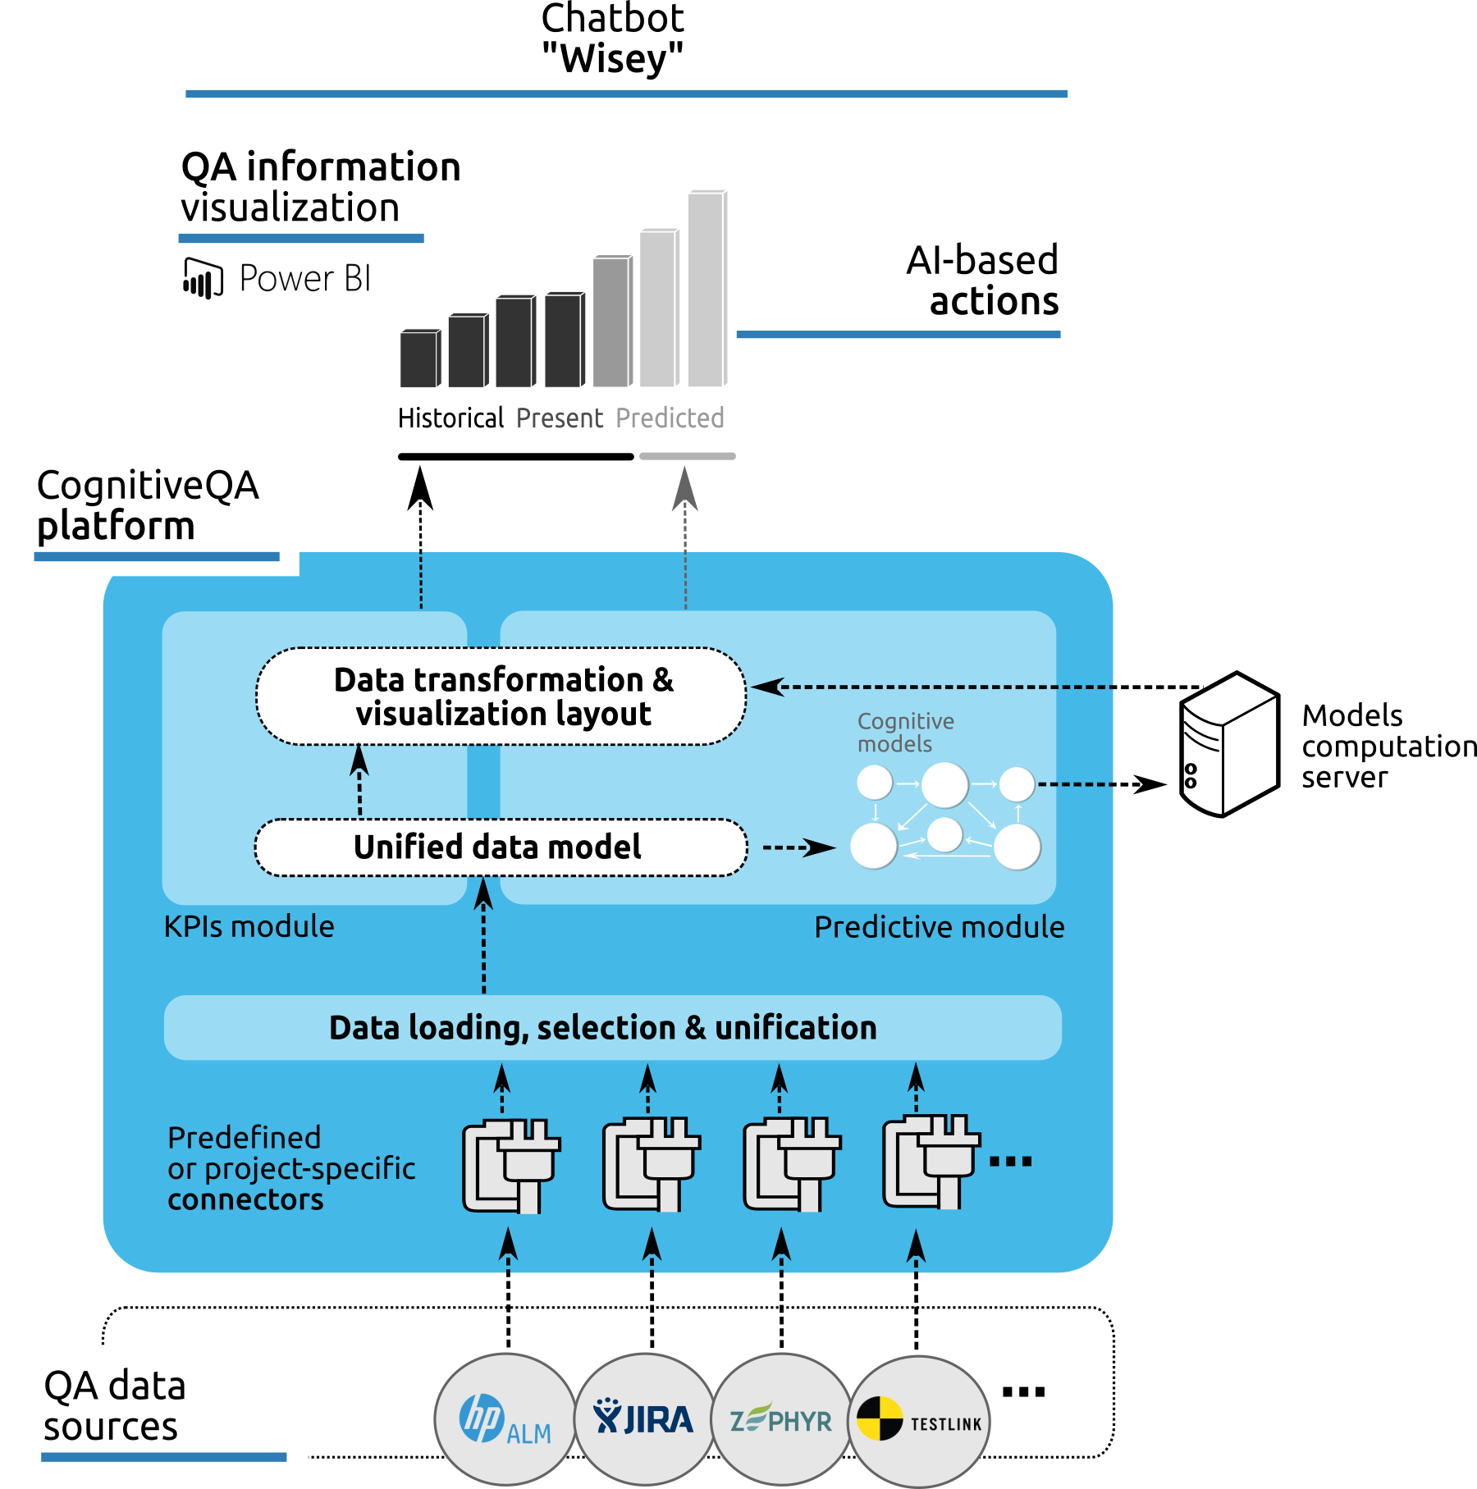
QADashbords & CognitiveQA

Slide 5
Portfolio 2020
QADashboards.
sogeti.es
Notes:
En esta presentación vamos a presentar el portfolio de servicios y soluciones de Sogeti España, incluyendo nuestras dos prácticas principales (Microsoft Solutions y Digital Assurance & Testing), bajo el lema “Value in the making”

Slide 6
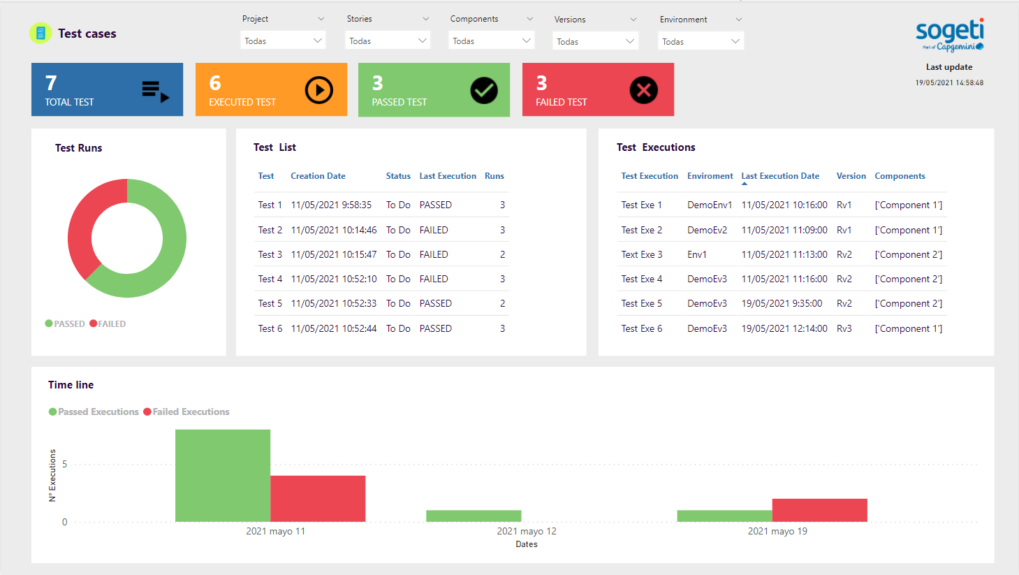
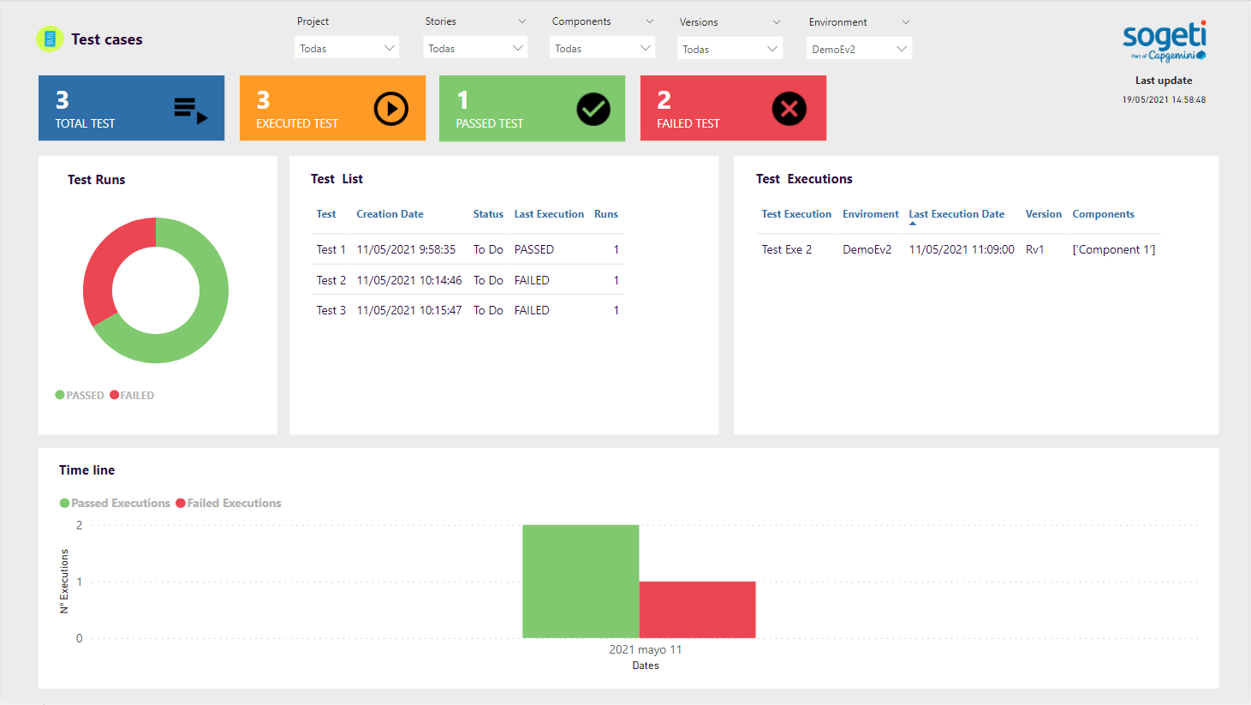
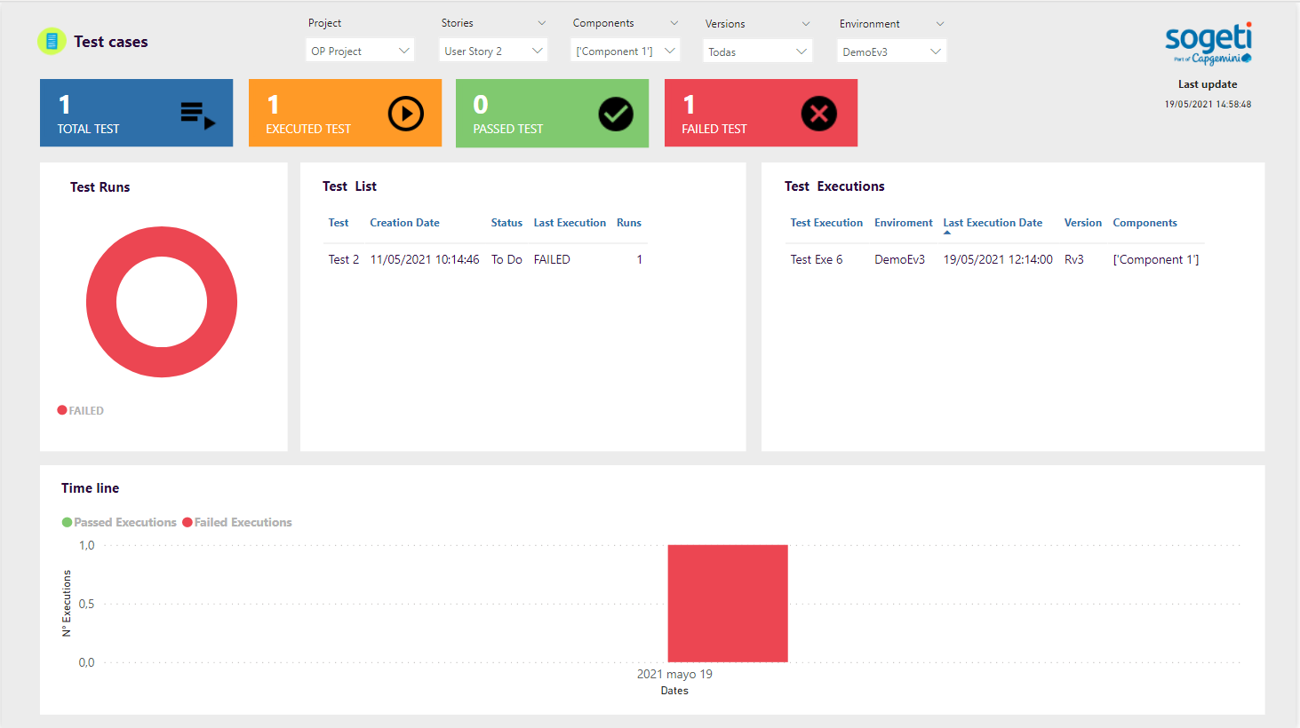
QA Dashboards
We process data related to quality assurance and we design & implement fully customized dashboards and analytical systems for testing & QA informed analysis.
“Take data further than operative use, improving analytics capabilities through customized and extensible automatic dashboards”
Fully customized quality dashboards
based on PowerBI and QADashboards platform, deployable on-premises or cloud.
Unified data model
that allows reliable dashboards development and reduces maintenance.
Automatic visualization
of metrics, filters and KPIs customized for each customer.
The VOICE model. Quality For DevOps teams book.
Filters
Dynamic filters with customized criteria.
Mutiple data source dashboards
We have predeveloped connectors to most of the existing QA related tools.
Pages
Visual components aggregator
The base for CognitiveQA
QADashboards is a base to be extended with CognitiveQA models.
Visual components
Graphical visualization of an indicator

Slide 7
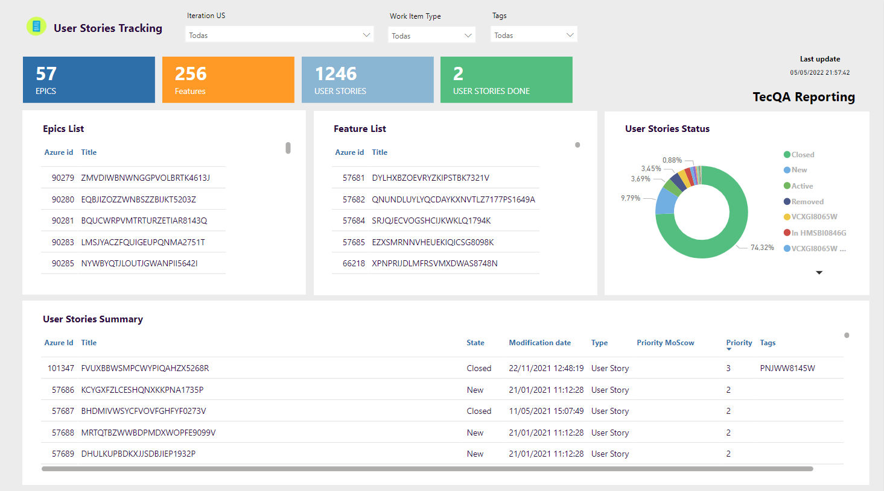
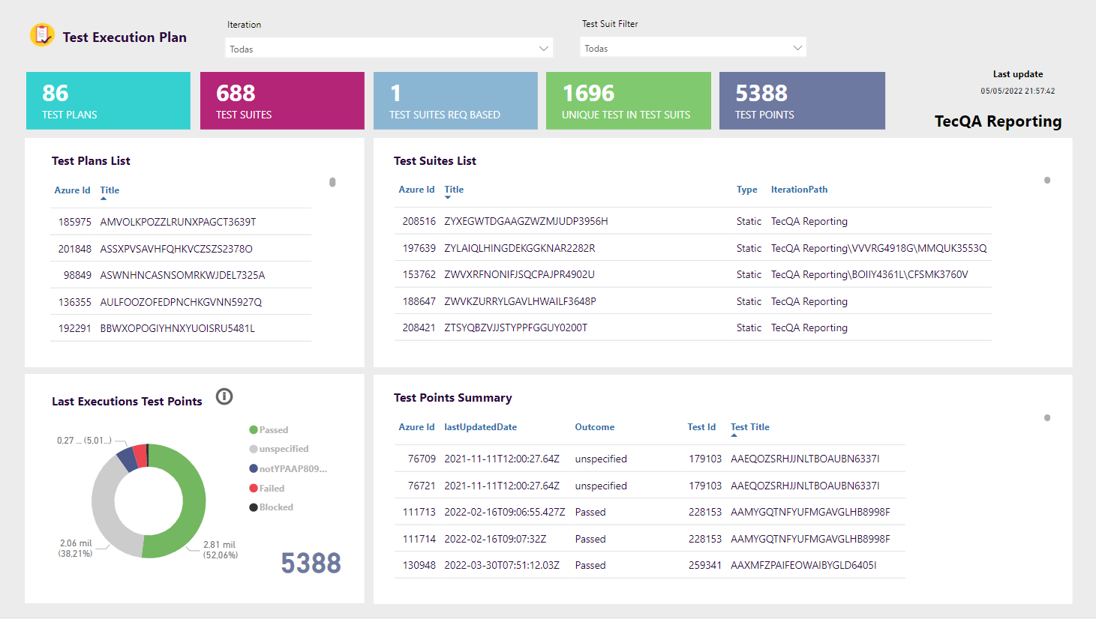
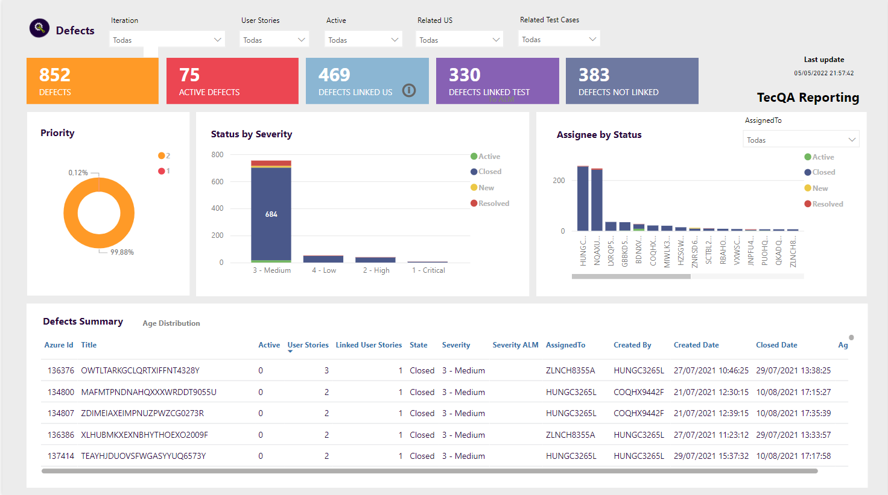
Metrics and KPIs
Make visible
Metrics and KPIs
QADashboards to make decisions
We take advantage of the capabilities and techniques of Business Intelligence (BI) for analysis, through custom dashboards.

Slide 8
QADashboards & QualityEye
QADashboards is a PowerBI-based solution to implement customized and automated quality dashboards. Quality Eye is a standalone implementation with predefined KPIs.
Sogeti Spain · Solution passports
Filters
Smart QA
Dynamic filters with customized criteria.
Pages
Through our solutions QADashboards, QualityEye and CognitiveQA we provide automated dashboards, insights and AI-based models to support Quality Engineering.
Value we bring
Visual components aggregator
Visual components
Graphical visualization of an indicator
Visibility of testing and quality engineering activities
AI-based assistance to prioritize test cases, maintain regression test cases, find duplicates,…
PowerBI-based or standalone implementations
CognitiveQA
CognitiveQA automatically assists testing and QA activities and decisions through smart analytics & AI-based models to predict and assist quality engineering decisions in projects.
“Which are the most important test cases to be executed with limited resources (effort, window execution time…)?
“Which test cases need to be added to the manual/automated regression set?”
“Are there potential duplicated defects or test cases?”

